Slide 1
TEAM kickflip
Presentation by: Shannon, Anona and Eduard

Slide 2
approach
Agreed tools for development
Assigned roles within the team
Agreed schema
Agreed on console based application rather than GUI
Assigned tasks to complete for each possible ‘sprint’ between client meetings
Set naming conventions in database
As issues were encountered, we reassigned based on who could best tackle the issue
Communicating with client when obstacles came up

Slide 3
Database schema

Slide 4
User roles in application
Developer – used by Shannon, Eduard, and Anona for development purposes that had same permissions as root
Views were created to execute the queries required for the appropriate user stories
PeopleTeam – select permissions on views for user stories 1, 2 and 3
FinanceTeam – select permission on view for user story 4
SalesTeam – select permission on view for user story 5
TalentManager – select permission on view for user story 6

Slide 5
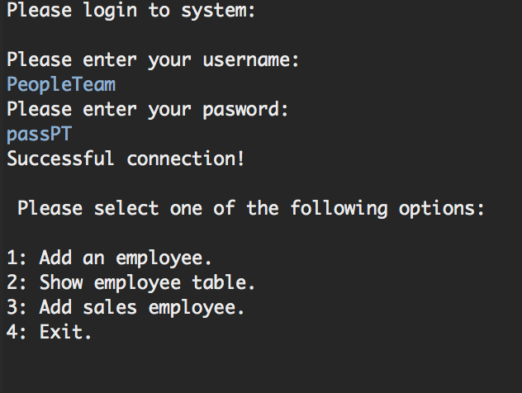
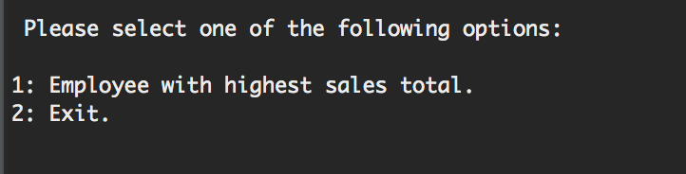
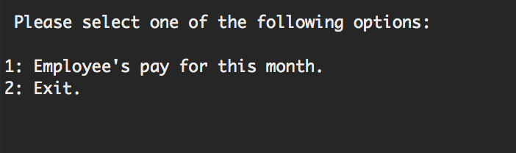
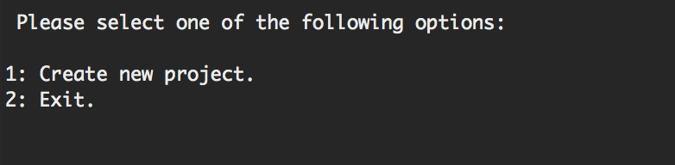
Menu viewed by different users
PeopleTeam
SalesTeam
FinanceTeam
TalentManager

Slide 6
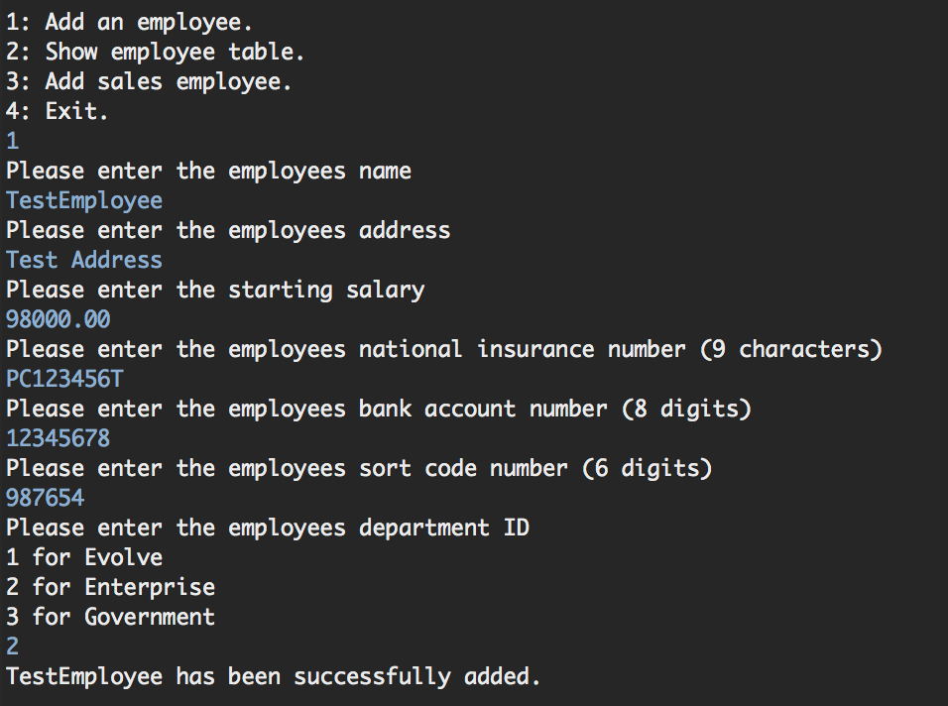
User story 1
“I want to enter employees' details so that the system records their information.”

Slide 7
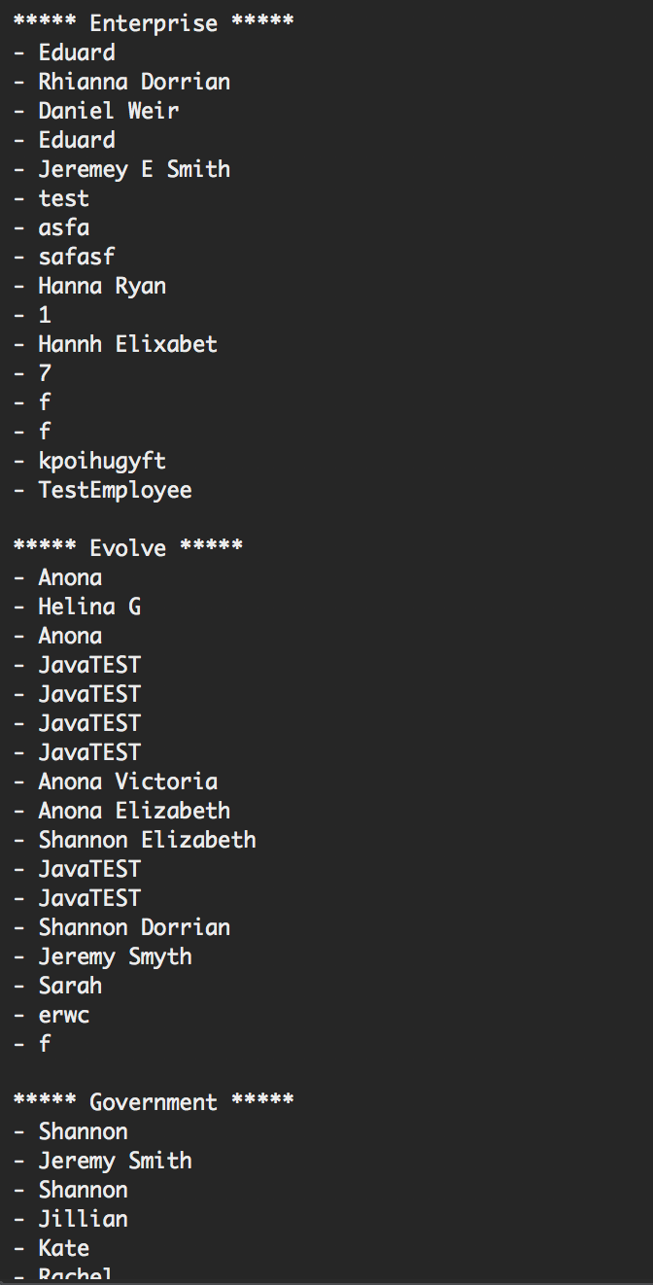
User story 2
“I want to generate a report containing employees per department so that BU heads can see who is in each department.”

Slide 8
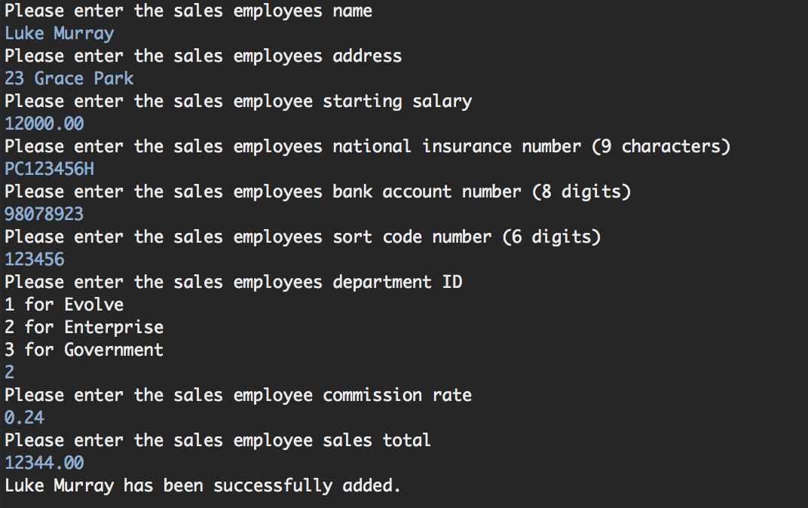
User story 3
“I want to be able to add Sales employees (employees who also have commission rate and total sales so far this period).”

Slide 9
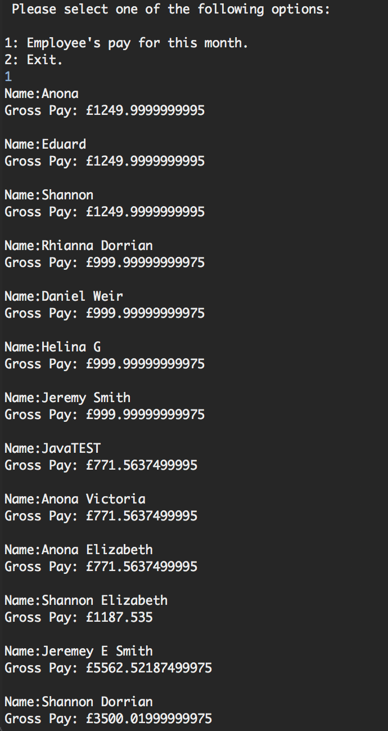
User story 4
“I want to generate a report containing each employee and their net pay for the current pay period”

Slide 10
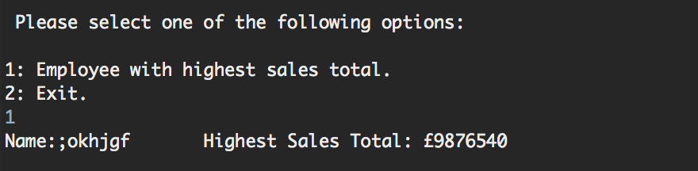
User story 5
“I want to see which sales employee has the highest sales total for this period so they can get many high fives.”

Slide 11
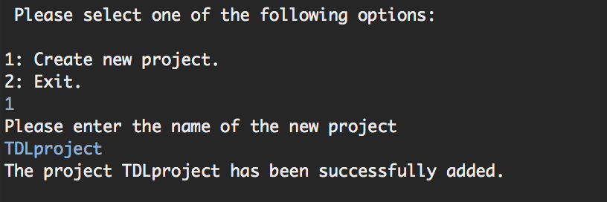
User story 6
“I want to create projects and assign employees to projects. I want to see which employees are assigned to each project.”
Please note, user story 6 had 3 parts and within the timeframe we completed the first part – “I want to create projects…”

Slide 12
Any questions?

